Slide 1

ML For Mind Sharpeners
Saeed Salehi

Slide 2
Who Am I?
//TODO

Slide 3
What is the machine learning?
It’s programming to unprogrammable!
//TODO: add some examples

Slide 4
What’s the difference?
Artificial Intelligence
Ability of a computer to perform tasks commonly associated with intelligent beings (reason , discover, meaning , generalize, learn from experience)
Machine Learning
Getting computers to make predictions without being explicitly programmed
Deep learning
Subset of ML based on artificial neural networks which imitate the way the human brain learns , thinks and process data
AI
Machine Learning
Deep learning

Slide 5
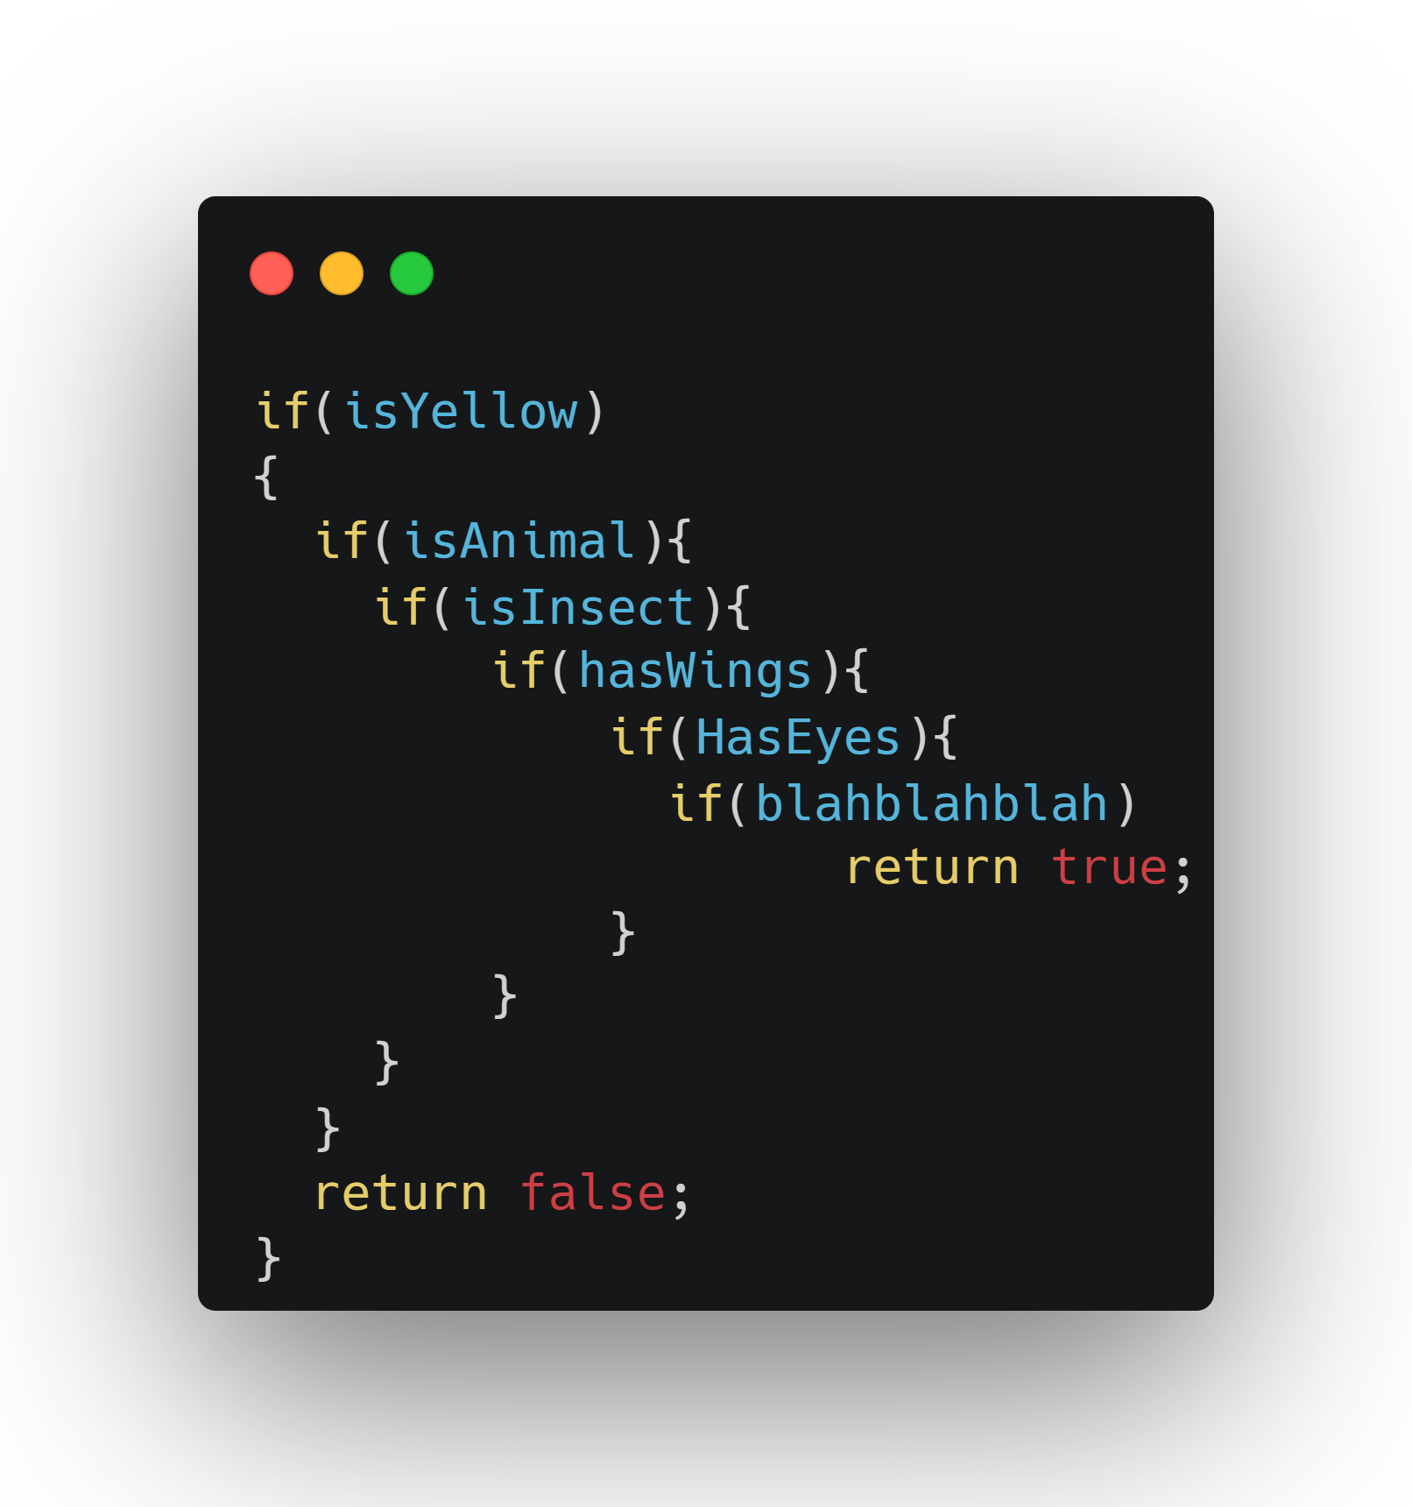


Classic Artificial Intelligence
Bee or not to Bee? That’s the question :)

Slide 6
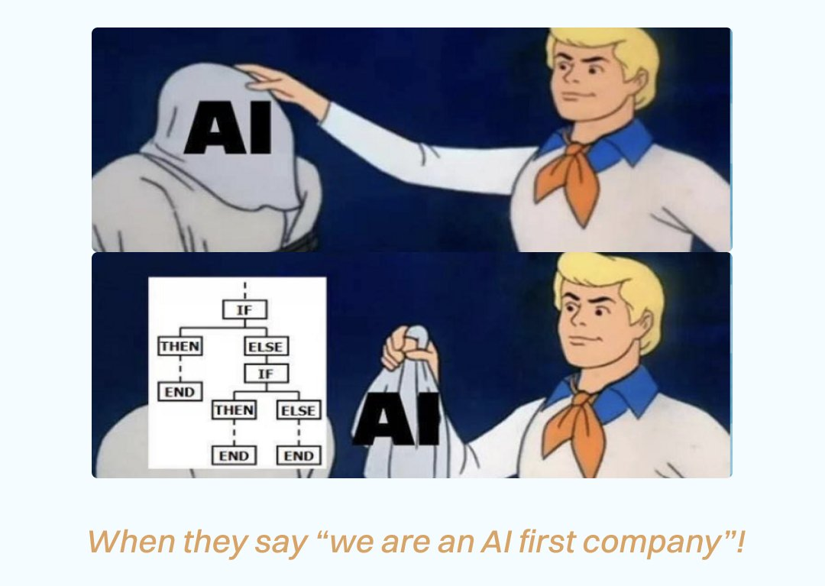

Slide 7
Comparison
Artificial Intelligence
Machine Learning
Rules
Data
Answers
Data
Answers
Rules

Slide 8
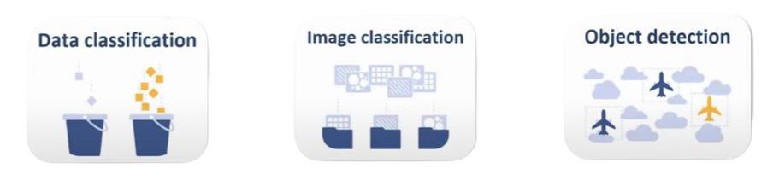
What kind of problems can be solved with ML?
Categorize Items

Slide 9
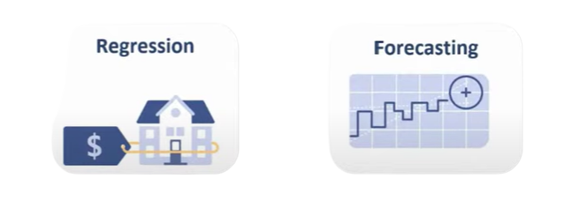
What kind of problems can be solved with ML?
Predict a value or number

Slide 10

What kind of problems can be solved with ML?
Make suggestion

Slide 11

What kind of problems can be solved with ML?
Find outliers

Slide 12
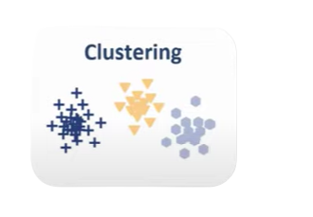
What kind of problems can be solved with ML?
Find relationships

Slide 13
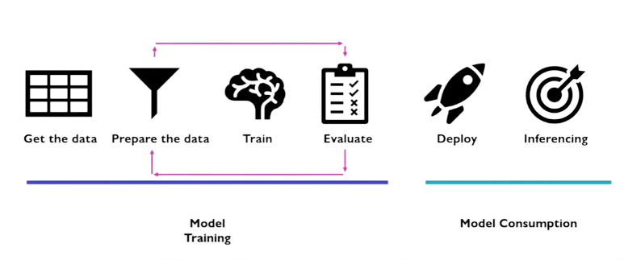
Workflow

Slide 14
Types of learning
Supervised Learning
Have labeled data (already tagged with right answer)
Try to find label of new data
Unsupervised learning
Do not have labeled data
Finds unknown patterns in data

Slide 15
Supervised Learning Iris Flower Classification

Slide 16
Unsupervised Learning Iris Flower Classification

Slide 17
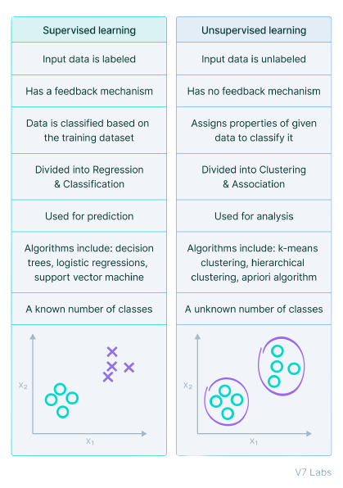

Slide 18

What is ML .Net?
ML.NET is a free, open-source, and cross-platform machine learning framework, created by Microsoft, for the .NET developer platform.

